Slide 1
EAS 5850:
IMAGING INFORMATICS
Introduction to Informatics and Working with Healthcare Data
Dr. Tessa S. Cook
Notes:
Module 1 is an introduction to informatics and working with healthcare data

Slide 2


Introduction to Module 1
Lesson 1: What is Informatics?
Different types of informatics
Where imaging fits in
Relationship between clinical informatics and imaging informatics
Lesson 2: Healthcare Data and Systems
Patient data vs. non-patient data
Confidentiality and compliance
De-identification of medical data
Patient and data safety

Slide 3
EAS 5850:
IMAGING INFORMATICS
Introduction to Informatics
Dr. Tessa S. Cook

Slide 4
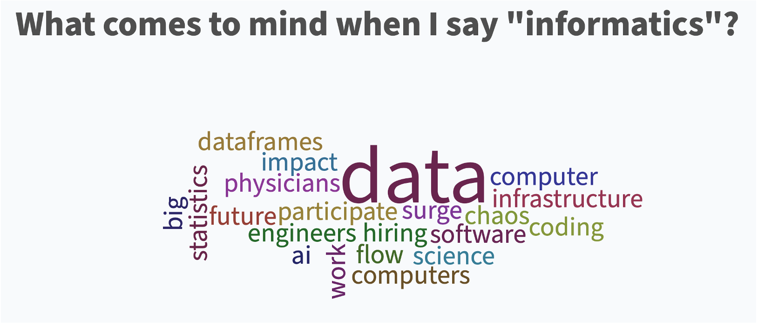
What is Informatics?
Wisdom
Knowledge
Information
Data
Notes:
I once asked my radiology residents what came to mind when they heard the word “informatics” and these were their responses. Not surprisingly, the vast majority first thought about data—which is the foundation of the data-information-knowledge-wisdom pyramid that permeates what we do in informatics.

Slide 5

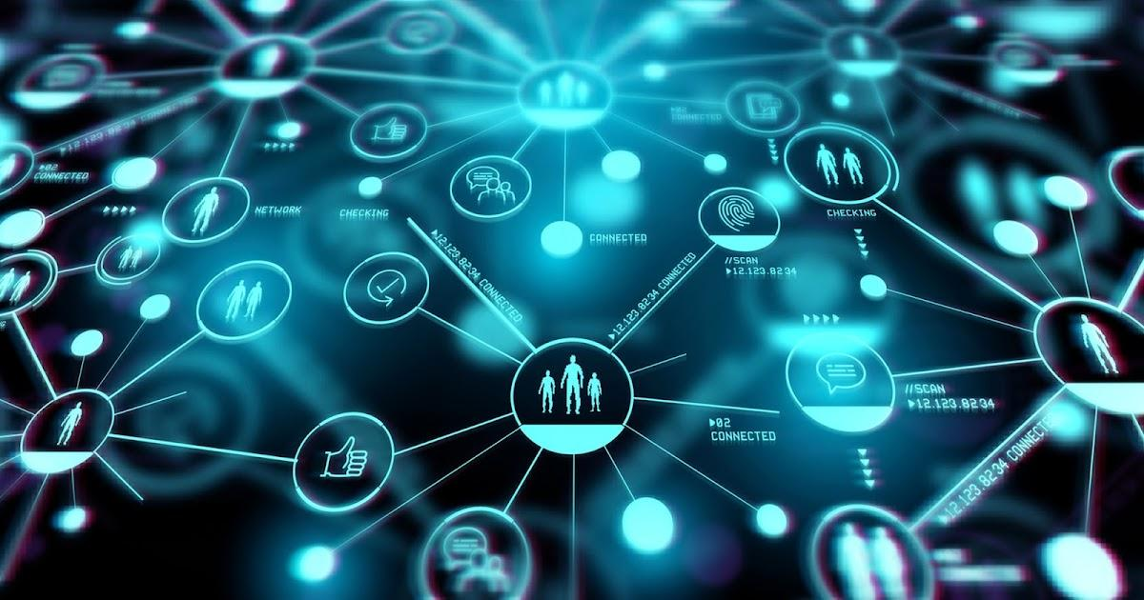
What is Informatics?
Improve human health and the delivery of health care services
Data, information, knowledge
https://amia.org/about-amia/why-informatics/informatics-research-and-practice
Notes:
According to AMIA, the American Medical Informatics Association, "Informatics is the science of how to use data, information and knowledge to improve human health and the delivery of health care services”. It often involves new technology but does not require it, and also depends closely on health IT

Slide 6


Informatics vs. Information Technology (IT)
Informatics
Human-computer interaction
IT
Computers & networking
https://www.ncbi.nlm.nih.gov/books/NBK470564/
This Photo by Unknown Author is licensed under CC BY-SA-NC
Notes:
”informatics” and “IT” are often used interchangeably, but refer to very different things.
Informatics:
The practice of information processing and the engineeri ng of information systems.
The field considers the interaction between humans and information alongside the construction of interfaces, organizations, technologies and systems.
IT: using computers to work with data & information
The two are intimately connected – we could not do informatics without IT! But where and how did the field of informatics, and in particular, biomedical informatics, originate?

Slide 7
Precursors to Informatics
Biomedical computing
Medical information science
“informatique” 🡪 Medical informatics
E.H. Shortliffe, J.J. Cimino (eds.), Biomedical Informatics, 2021
Notes:
In the 1960s, although computing itself was still relatively nascent, people were using it with biomedical and clinical data.Then, in the1970s, this field became defined as “medical computer science”, to reflect the fact that computer science was being applied to medical data. “Biomedical computing” was another description used, but it was rather vague. “Medical information science” was also used, but did not really capture the depth and breadth of the work that was being done. Subsequently, the term “medical informatics” originated from the French word for computer science, “informatique”, particularly because the information aspect was realized to be just as important if not more so than the computer piece.

Slide 8

Health Informatics
E.H. Shortliffe, J.J. Cimino (eds.), Biomedical Informatics, 2021
This Photo by Unknown Author is licensed under CC BY-ND
Notes:
Medical informatics was felt to be too physician-focused, so the term health informatics was introduced to apply to broader clinical domains and roles, including public health, but not research

Slide 9
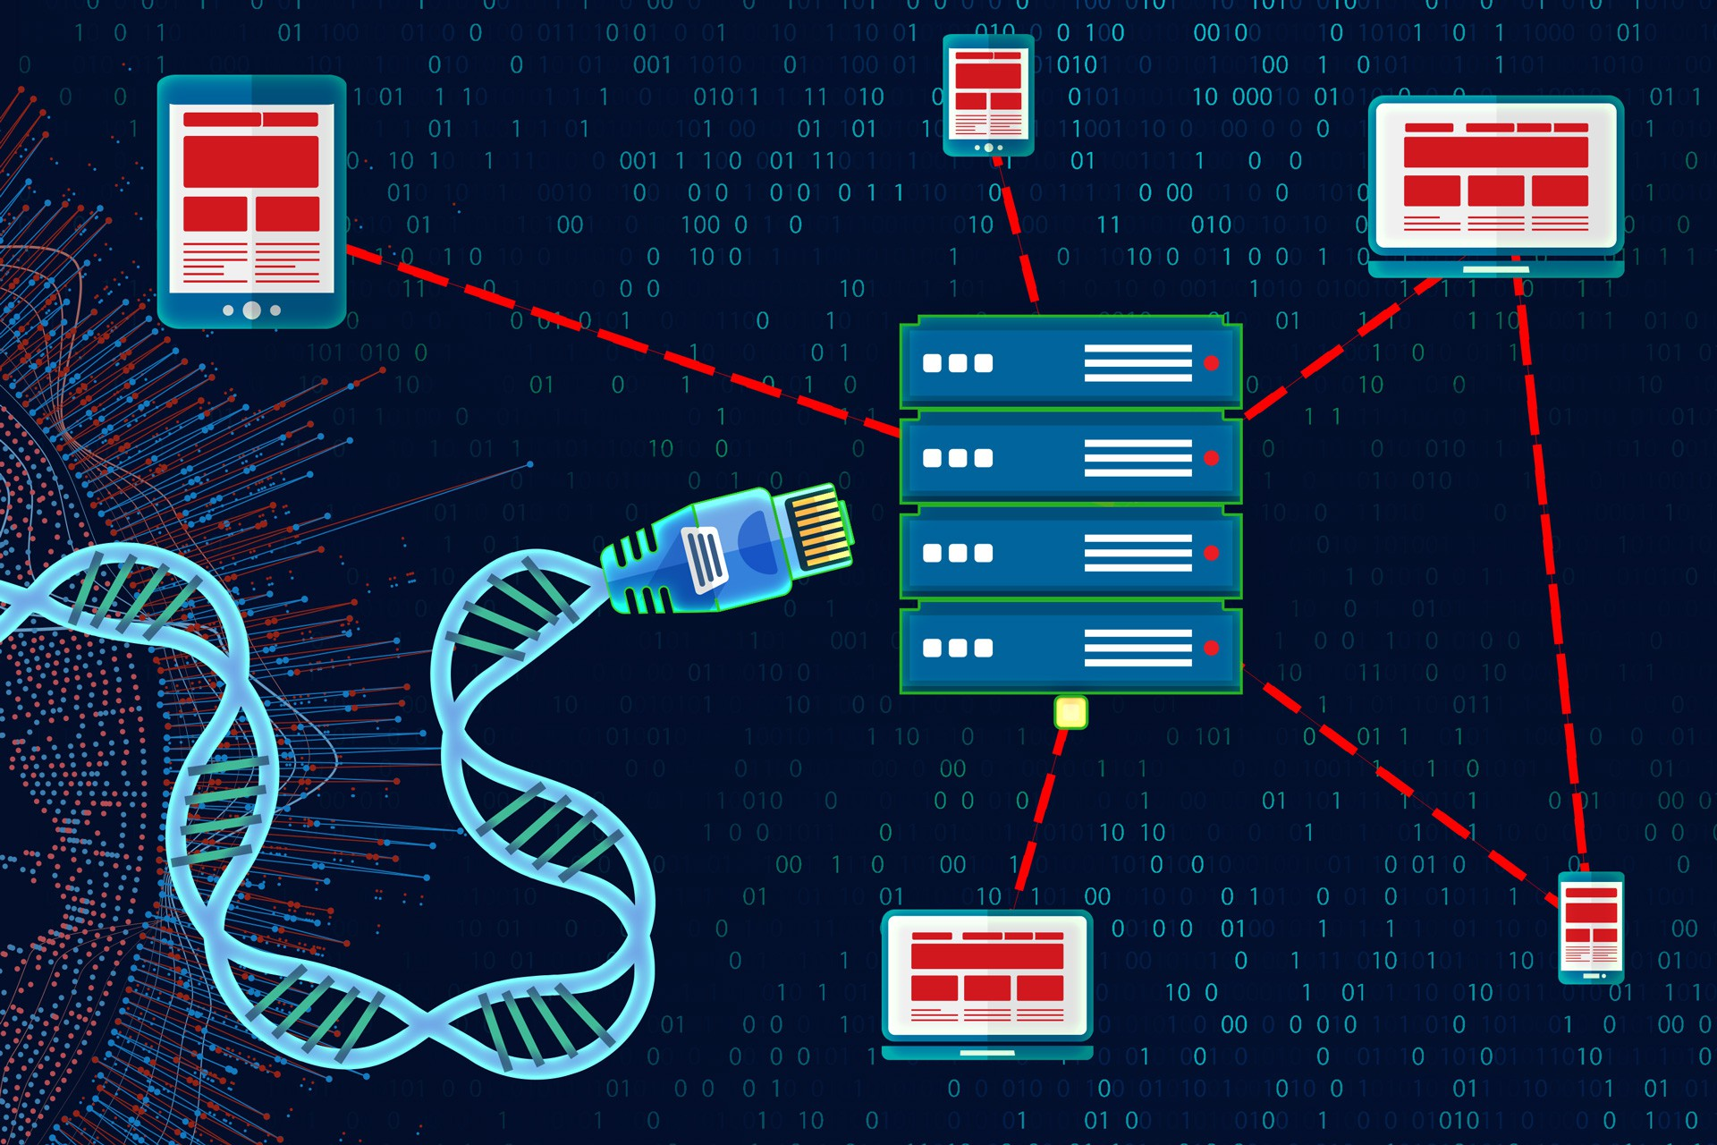
Bioinformatics
E.H. Shortliffe, J.J. Cimino (eds.), Biomedical Informatics, 2021
This Photo by Unknown Author is licensed under CC BY
Notes:
In later years, bioinformatics began to be used to describe the domain of informatics devoted to biology and genetics, including the success of the human genome project. However, this term did not include medical informatics, which was more clinically focused.

Slide 10

Biomedical Informatics
Biomedical informatics
E.H. Shortliffe, J.J. Cimino (eds.), Biomedical Informatics, 2021
This Photo by Unknown Author is licensed under CC BY
This Photo by Unknown Author is licensed under CC BY-ND
Notes:
To address this limitation, the term “biomedical informatics” then began to be used to identify the combined domains of medical informatics and bioinformatics. Biomedical informatics covers both the basic science and the applied science aspects of the field.

Slide 11
Domains of Biomedical Informatics
Clinical informatics
Medical
Dental
Nursing
Veterinary
Public health informatics
Individual 🡪 population
Bioinformatics
Public Health Informatics
Imaging Informatics
Clinical Informatics
E.H. Shortliffe, J.J. Cimino (eds.), Biomedical Informatics, 2021
Notes:
There are many different domains of biomedical informatics, including (list what’s on the slide). These domains overlap and intersect to different degrees. We already discussed bioinformatics, which deals with the information science of biology and genetics. Clinical informatics covers a broad number of areas of healthcare delivery, including (list what’s on slide). Our focus in this course will be imaging informatics, which is a subdomain of clinical informatics. Later in this module, we will discuss how and why imaging informatics and clinical informatics are so closely related.

Slide 12
Next: Imaging Informatics
This Photo by Unknown Author is licensed under CC BY-NC-ND
Notes:
Next, we’re going to talk about imaging informatics, the main focus of this course. Although imaging informatics began in radiology, it has since expanded across many different clinical specialties, including cardiology, dermatology, pathology, ophthalmology, and more. Imaging informatics across a healthcare system is referred to as “enterprise imaging”, which we will discuss in detail in a later module. When I asked PowerPoint to suggest an image for “enterprise imaging”, this is what it came up with. When we discuss artificial intelligence, we’ll talk more about why this might have happened!

Slide 13
EAS 5850:
IMAGING INFORMATICS
Introduction to Imaging Informatics
Dr. Tessa S. Cook

Slide 14

Imaging Informatics
Information science
=
Healthcare
Computer science
Notes:
(from Wikipedia) A subspecialty of biomedical informatics that aims to improve the efficiency, accuracy, usability, and reliability of medical imaging services within the healthcare enterprise. Devoted to the study of how information about and contained within medical images is retrieved, analyzed, enhanced, and exchanged throughout the medical enterprise.

Slide 15
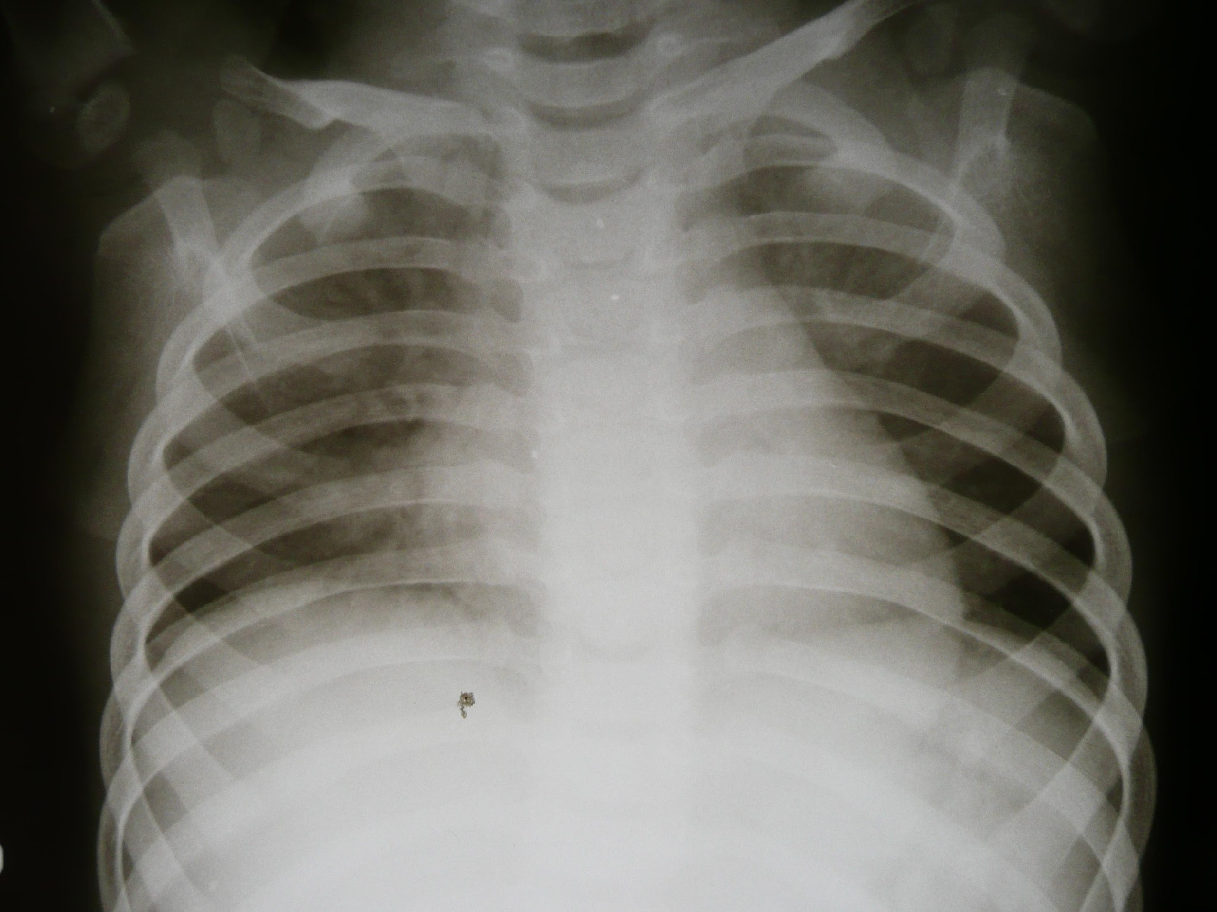
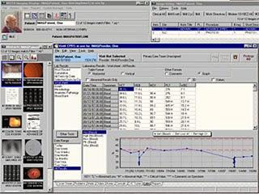
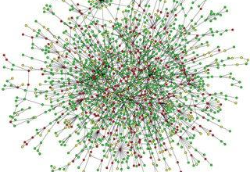
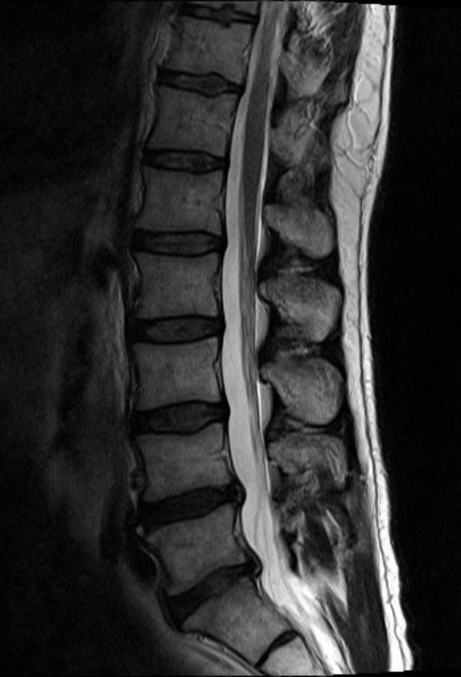
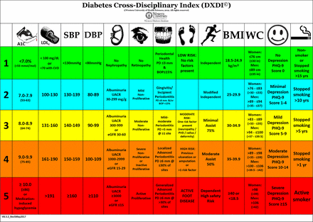

Notes:
Even though Wikipedia would define imaging informatics to be centered around how medical images are exchanged and used in complex healthcare systems, I would argue that it has to do with so much more than the images themselves. Although pixel-based data is a huge part of imaging informatics, we also generate a lot of non-pixel based data, in the form of metadata that accompanies the images, measurements of structures on the images, other kinds of quantitative analysis, and text-based interpretations of the images. We also generate data that are reincorporated into the EMR – the electronic medical record. And now with AI, there are postprocessed data that also fall under imaging informatics.

Slide 16















Informatics Specialty Societies
Notes:
There are many informatics specialty societies – some of them are more technical, such as DICOM, HL7, IHE, and MITA, the Medical Imaging and Technology Alliance of manufacturers. There are clinical informatics societies, such as AMIA and HIMSS. And there are imaging societies for the different specialties, radiology, cardiology, pathology, and others, including RSNA, ACR, API, DPA, ISDIS, and more. There are even international societies, such as EuSoMII and KSIIM.
The International Society for Digital Imaging of the Skin (ISDIS)
International Skin Imaging Collaboration (ISIC)

Slide 17


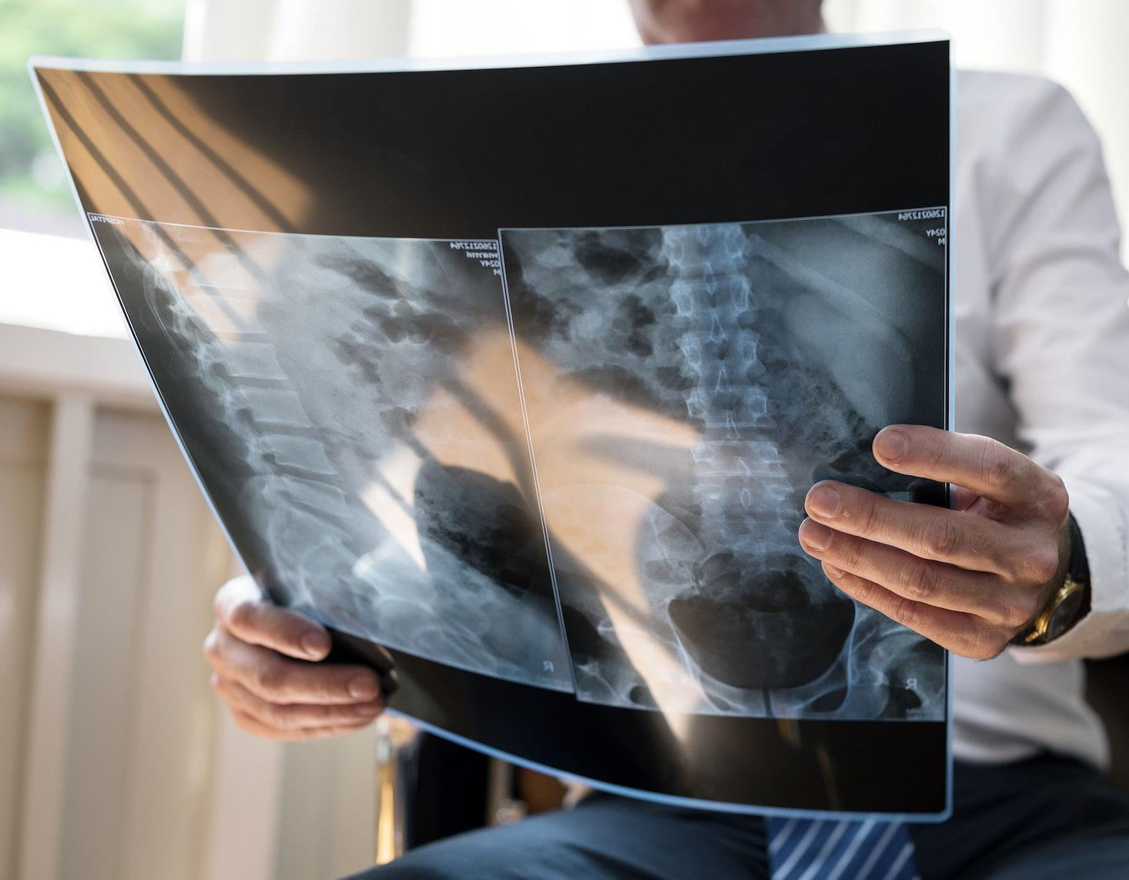


Where Imaging Informatics Began
RADIOLOGY
Notes:
To revisit the birth of the field of imaging informatics, we have to go back in time to the early days of radiology. Radiology is a specialty of medicine focused on diagnosing and treating disease using medical imaging. Types of medical imaging we use today include X-rays, computed tomography (also known as CT scans), magnetic resonance imaging (or MRI), and molecular imaging (that can look at physiologic processes in the body). Imaging informatics began in radiology, because we had more digital data than any other area of medicine. In fact, in the early days of radiology, we actually converted our digital data to analog data so it could be viewed, distributed, and stored! The medium for this was film.

Slide 18
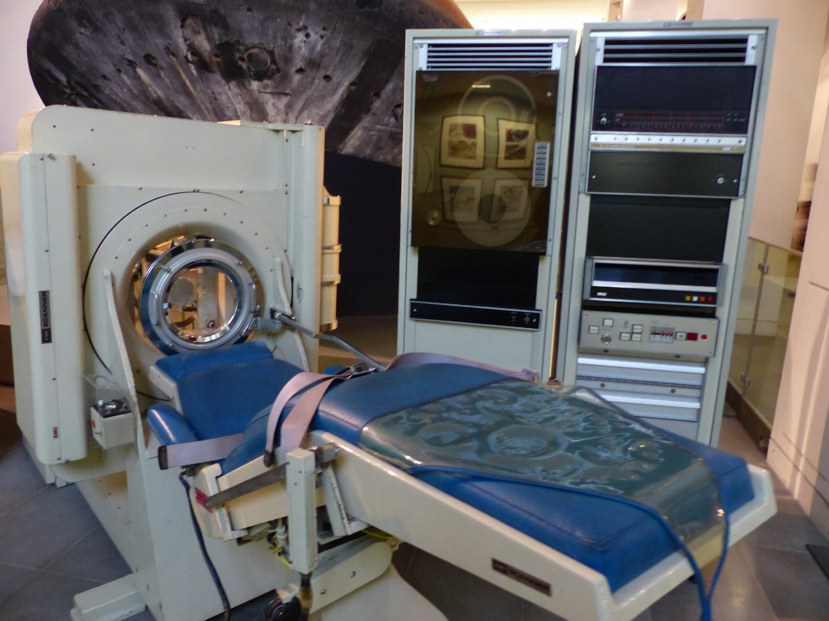
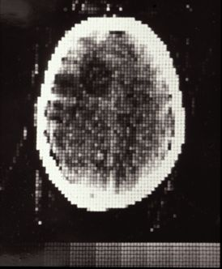

The First Head CT
Godfrey Hounsfield, EMI Central Research Labs
October 1, 1971: Atkinson Morley’s Hospital
http://www.impactscan.org/CThistory.htm
Notes:
Roentgen first discovered X-rays in 1895. Between then and the 1960s, radiology was practiced using X-rays and fluoroscopy (X-rays with multiple image exposures rather than a single exposure). Then, in the 1970s, things changed with the development of CT.
EMI (Electrical and Music Industries, London; recording studio Abbey Road, label for the Beatles); Hounsfield – EE at EMI
80x80 matrix, 5 min reconstruction per slice (2 slices?). Patient with frontal lobe tumor, surgeon said it “looked exactly like the image”
First body CT in 1975

Slide 19
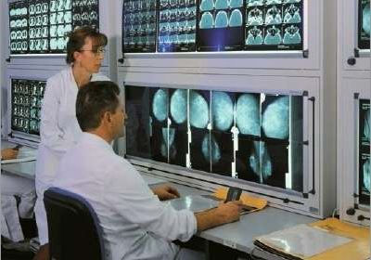
Radiology of “Old” (pre-1990s)
http://mexindia.tradeindia.com
Notes:
Film, lightbox, alternator
No digital data reached the radiologist or was stored for later retrieval and study.

Slide 20
Before PACS
PACS = picture archiving and communication system
Before PACS, radiology was entirely film-based
Slow image acquisition & film post-processing
Fewer imaging studies each day
Films hung up before for review by radiologist
Reports handwritten or tape-recorded 🡪 transcriptionist

Slide 21
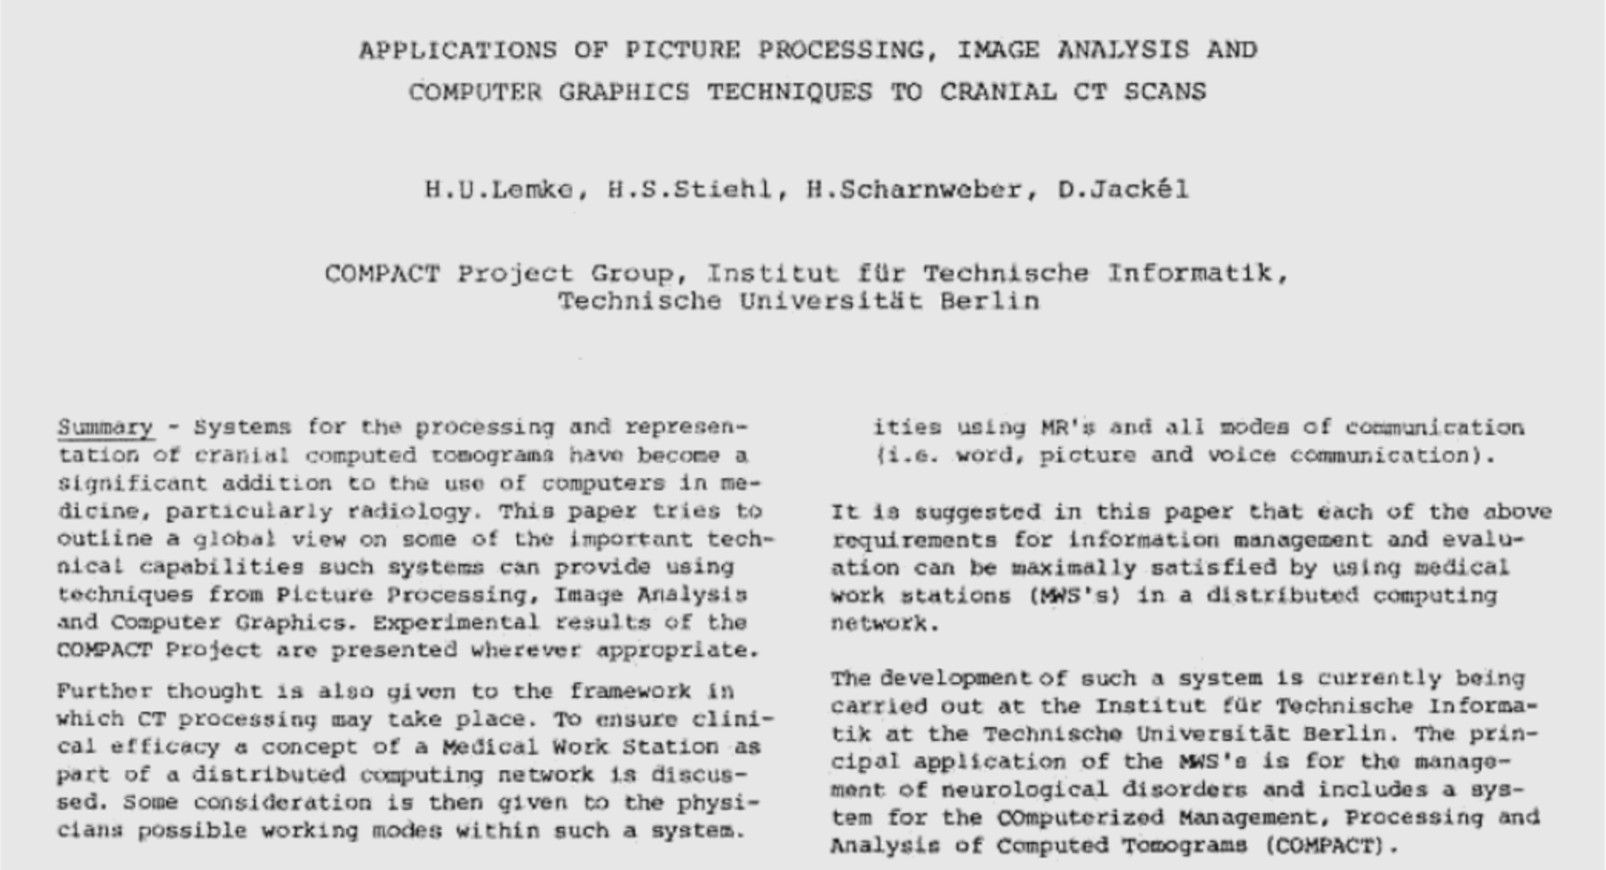
PACS in utero
Notes:
The earliest mention of what would eventually become PACS came from Dr. Heinz Lemke, a computer scientist working in Germany at the time. He described the idea of a medical workstation as part of a distributed computing network, which would allow people to view images in a separate location from where they were acquired on the imaging equipment.

Slide 22
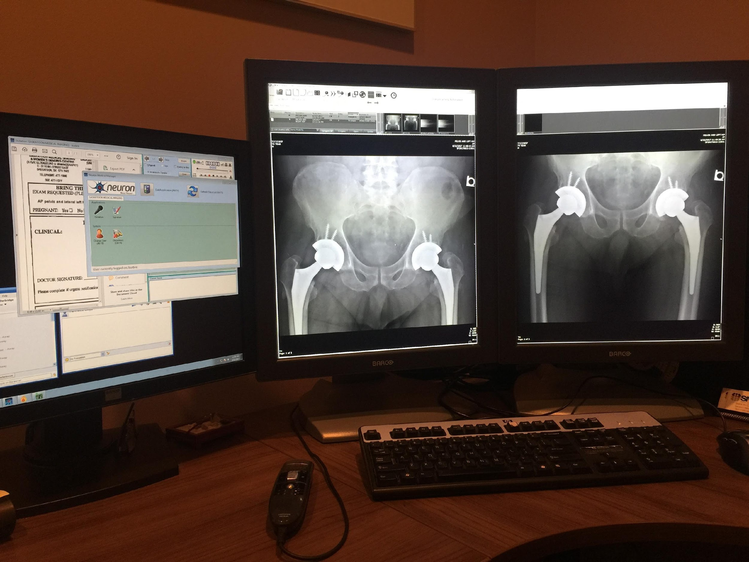
1982: PACS is Born
Great deal of research in the 1980s-90s
Considerations of scale
Workstations
Networking
Storage
Considerations of cost
Save money? Replace film entirely?
H.K. Huang / European Journal of Radiology 78 (2011) 163–176
This Photo by Unknown Author is licensed under CC BY-SA-NC
Notes:
Term coined in 1982 at an SPIE conference
Great deal of research in the 1980s-90s
Government investment
Considerations of scale
Single modality + viewing station vs. multiple modalities and distributed viewing
Network capacity
Storage capacity
Considerations of cost
Was it going to save money? Replace film entirely?

Slide 23
The Finances Were Problematic
Cost of a CT scanner in the 1980s:
$2,000,000
Cost of a PACS in the 1980s:
$9,200,000
Notes:
Much debate/controversy about cost effectiveness
If you were the head of a radiology department or practice, where would you spend your $$?

Slide 24
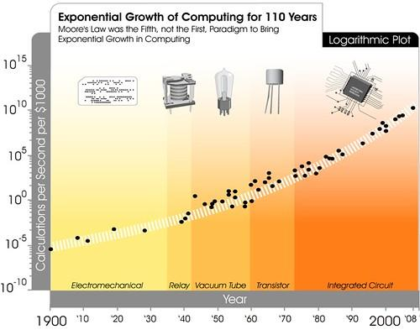
Moore’s Law Helped…A Lot
Computer $ ⬇️ 🡪 PACS $ ⬇️
Storage still $$$
Rapid introduction of new and better technology 🡪 more PACS
This Photo by Unknown Author is licensed under CC BY
Notes:
As computer hardware became cheaper, PACS prices dropped
For a while, storage was still expensive
Rapid introduction of new and better technology made PACS more accessible

Slide 25
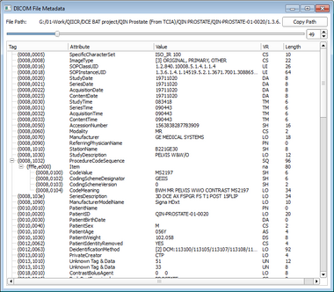
1990s: DICOM
Digital Imaging and Communications in Medicine
The standard for storage, transfer, display and processing of medical image data
Ongoing development (working groups): visible light, dermatology, dentistry, pathology, AI, web services, neurophysiology data, surgery, data archive & management, etc.
This Photo by Unknown Author is licensed under CC BY-SA
Notes:
Digital Imaging and Communications in Medicine
The standard for storage, transfer, display and processing of medical image data
Introduced in the early 1990s and continuing to evolve (working groups)

Slide 26
ALPHABET SOUP OF IMAGING INFORMATICS
PACS
DICOM
RadLex
RIS
HL7
IHE
VNA
FHIR
CDE
MWL
SR
SLA
RFP
ABII
CIIP
Notes:
Learning imaging informatics is somewhat like learning another language – we have tons of acronyms – these are just a few. They refer to standards, systems, certifications, and technologies that we use in the field. As we go through the course, you’ll learn about each of these—and more--in detail.

Slide 27





Hot Topics in Imaging Informatics
Standards & interoperability
Enterprise imaging
Workflow optimization
Artificial intelligence
Patient-centered care
Notes:
These touch many clinical specialties, not just radiology. Cards, path, ophtho, derm, and more. In a subsequent lecture, we’ll talk about how and why imaging informatics and clinical informatics are closely connected.

Slide 28
EAS 5850:
IMAGING INFORMATICS
The Intersection of Imaging Informatics and Clinical Informatics
Dr. Tessa S. Cook

Slide 29
Quintuple Aim of Healthcare
Improve population health
Enhance the care experience
Decrease cost of care
Improve workforce well-being
Address health equity

Slide 30

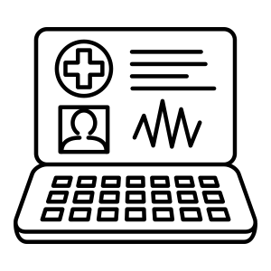


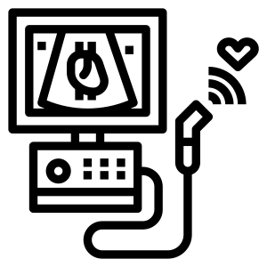

Imaging and Clinical Informatics: Closely Related
Imaging Informatics
Clinical Informatics
Notes:
Imaging informatics and clinical informatics are very closely related fields, despite their different names. Both exist in the domain of patient care and health. Clinical informatics focuses more on the electronic medical record – the EMR – and optimizing its features and its use for patient care. Imaging informatics focuses more on medical imaging – in fields such as radiology, cardiology, pathology, dermatology, ophthalmology, dentistry and more – and the systems needed to generate, store, view, and transfer those images. However, those systems often need to interface very closely with the EMR, and so imaging informatics deals with those interfaces and with the necessary data. In addition, imaging occurs throughout the clinical enterprise, not just within departments like radiology or cardiology, that might have their own specific workflows. As a result, imaging informatics must also happen within clinical informatics.

Slide 31
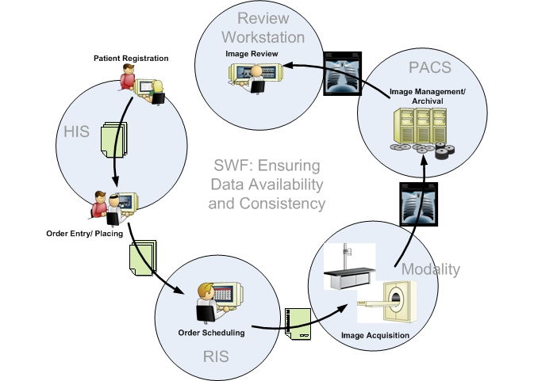
Imaging and Clinical Informatics in the Same Workflow
http://wiki.ihe.net/index.php?title=Scheduled_Workflow
Notes:
This is a diagram of the IHE Scheduled Workflow Profile. Although there are some paper-based steps in this diagram, in modern healthcare all of these are now electronic transactions. We’ll talk about the transition from paper to digital as well as about IHE, profiles, and technical frameworks in more detail later in the course. But for now, I want you to appreciate how closely clinical informatics and imaging informatics are connected. Scheduled Workflow describes the interoperability of clinical systems such as the HIS (health information system), also known as the EMR, and imaging informatics systems, such as the RIS, PACS, and workstation.

Slide 32
Imaging and Clinical Informatics in the Same Workflow
http://wiki.ihe.net/index.php?title=Scheduled_Workflow
Notes:
For a patient to get an imaging test in radiology, they must first be registered with the imaging facility. That might be a standalone outpatient center or a hospital-based facility.

Slide 33
Imaging and Clinical Informatics in the Same Workflow
http://wiki.ihe.net/index.php?title=Scheduled_Workflow
Notes:
Scheduling takes place in the RIS, the radiology information system. This requires the correct patient information and order information to be available from the EMR, so that the patient can be scheduled for the right test at a location that can perform it.

Slide 34
Imaging and Clinical Informatics in the Same Workflow
http://wiki.ihe.net/index.php?title=Scheduled_Workflow
Notes:
Images are sent to PACS, where they need to be added to the correct patient’s “jacket” (a legacy term from when films from the same patient were kept together in a big folder). The right images should also then be available to the radiologist for interpretation and comparison to prior imaging. Although not represented on this figure, the results and sometimes even the images are now also available directly to patients through the electronic patient portal.

Slide 35
ALPHABET SOUP OF CLINICAL INFORMATICS
EMR
HL7
FHIR
CDS
CPOE
HCI
ICD
CPT
AMIA
HITECH
HIPAA
LIS
Notes:
You might not be surprised to learn that clinical informatics has its own alphabet soup of terminology. Thankfully, there is overlap in the terminology between imaging informatics and clinical informatics, given that the two fields are so closely intertwined. Later in the course, we’ll dig into the clinical workflow in more detail and explore the data, systems, and standards that are integral to both fields. We’ll also look more closely at enterprise imaging, which includes imaging across the various departments of a healthcare system, not just within radiology.

Slide 36
EAS 5850:
IMAGING INFORMATICS
Types of Healthcare Data
Dr. Tessa S. Cook

Slide 37
Types of Healthcare Data
Patient data
Non-patient data
Healthcare Data
Clinical data
Research data
Notes:
There are many types of data in healthcare, which is another reason why informatics is so important. Broadly, you can think of data as patient data vs. non-patient data, or clinical data vs. research data. But these categories can also overlap with one another in some instances.

Slide 38

Patient Data
Notes & documents
Vital signs
Test results
Images
Vaccinations
Medications
Administrative
Notes:
Patient data consists of the following (list)
Notes and documents – office visits, inpatient or ED progress notes, procedures
Administrative data belong to both patients as well as the system at large – at the patient level, these include appointment information and insurance and billing data

Slide 39

Non-Patient Data
Utilization
Retention
Access
Finances
Contracts
Medicolegal
Notes:
There are many types of non-patient data (list).
Think of these data as the data necessary for the “business of healthcare”. This is usually collected at an organizational level, whether it’s for a particular department within a hospital, a particular hospital within a health system, or for the entire system consisting of multiple hospitals and sites. Although this data is typically used to optimize processes, it can still ultimately improve patient access and patient experience.

Slide 40
Clinical Data
Data used primarily to deliver patient care in various settings
Can subsequently be used for research with approvals
Notes:
Settings – inpatient, outpatient, emergency room, urgent care, standalone facility (PT, rehab, etc.)
This is typically data stored in the electronic medical record – also known as the EMR – that is collected while patients are being taken care of.

Slide 41
Research Data
Primarily acquired for scientific study
Occasionally reveals abnormalities that require medical attention
Notes:
One important nuance here is that clinical data can become research data, but that the latter is rarely the case. Particularly in imaging, data acquired for research may include experimental methods and techniques that are not yet ready for prime time, and potentially collected in very closely controlled scenarios intended to answer a specific research question. To turn around and use these data for patient care may not be appropriate as the techniques may not be ready for prime time. If suspicious findings are discovered during acquisition for research data, research participants are usually referred to their primary care provider or connected with a clinician that can provide the appropriate follow-up.

Slide 42
Protected Health Information (PHI)
Defined by the Health Insurance Portability and Accountability Act (1996), aka HIPAA
Administered by the US Department of Health and Human Services (HHS)
PII
PHI
Notes:
PHI is an acronym often confused with PII. So what is PII – personally identifiable information – versus PHI – protected health information?

Slide 43
PII vs. PHI
Personally Identifiable Information (PII)
Any information that can identify you
Card numbers
Addresses
Biometrics
Electronic identifiers
Protected Health Information (PHI)
Subset of PII used in healthcare
covered by HIPAA
18 specific types of identifiers
Notes:
In a future lecture we’ll talk more about regulations such as HIPAA in the US and others elsewhere in the world that apply to PHI

Slide 44
EAS 5850:
IMAGING INFORMATICS
Confidentiality and Compliance
Dr. Tessa S. Cook

Slide 45
Protecting Patients’ Data
HIPAA/HITECH
GDPR
Data ownership
Patient access to records
Notes:
In a prior lecture, we chatted briefly about HIPAA, legislation in the US that protects patients’ healthcare data. In this lecture we’ll elaborate on the different components of HIPAA and how they impact healthcare from the informatics standpoint. We’ll also discuss other US regulations and some international regulations that impact what can be done with patient data.

Slide 46
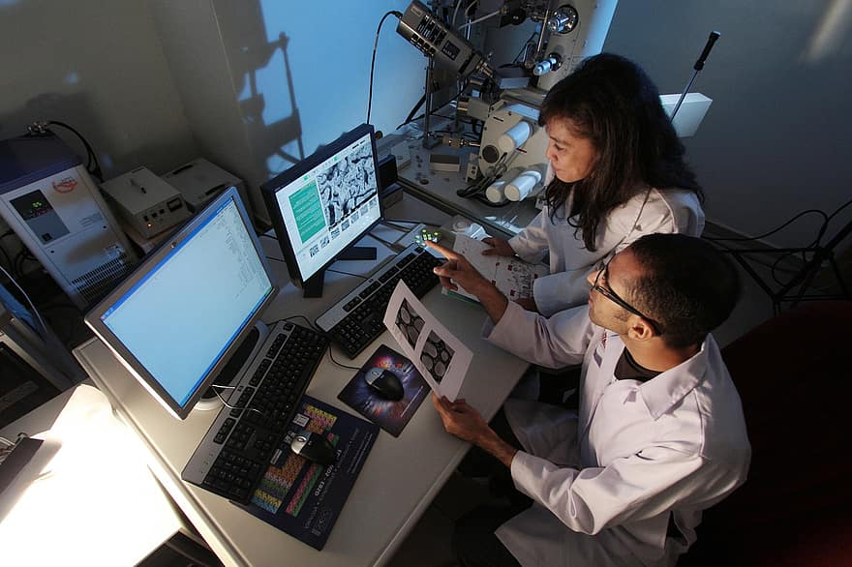

Confidentiality for Research vs. Clinical Data
Data almost always de-identified
“Limited dataset” can be shared with PHI
Identifying data retained in the records
Data for clinical care – patients can authorize sharing
This Photo by Unknown Author is licensed under CC BY-NC-ND
Notes:
Limited dataset – excludes direct patient identifiers but can retain dates, zip codes, city/state, other non-direct identifiers
Sharing limited dataset requires DUA, which we’ll talk more about in another lecture

Slide 47
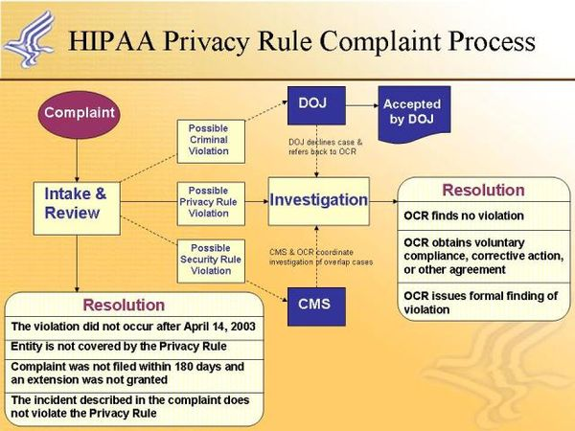
HIPAA (1996)
Health Insurance Portability and Accountability Act
National standards to protect PHI
Applies to covered entities that conduct electronic transactions
Violations & breach notifications
This Photo by Unknown Author is licensed under CC BY-SA
Notes:
Multiple components including privacy and security rules
There are four tiers of HIPAA violations of HIPAA should be reported as breach notifications – to the affected individuals, the media, and the Secretary of HHS, within a certain period of time. Depending on how many patients are affected, the notification requirements are different. There are also financial penalties for each violation that are higher for the higher tiers.

Slide 48
HIPAA Privacy Rule
Limits disclosure of PHI without individual’s authorization
Option for waiver for research
Individual rights to
Obtain copy of their records
Request corrections
Direct covered entities to transfer records electronically
Healthcare providers
Covered entities
Health plans
Health clearinghouses
https://www.hhs.gov/hipaa/for-professionals/privacy/index.html

Slide 49
HIPAA Security Rule
Administrative
Password management, BAAs, internet use
Technical
Network, systems
Physical
Badge entry, cameras, RFID, data center security
Physical
Administrative
Technical
Safe-guards
https://www.hhs.gov/hipaa/for-professionals/security/index.html
Notes:
The Security Rule requires appropriate administrative, physical and technical safeguards to ensure the confidentiality, integrity, and availability of electronic PHI
Network – firewalls, intrusion detection systems, audit trails, network access control, VPNs
Systems – authentication, access logs, antivirus, firewalls, encryption

Slide 50
HIPAA Security Rule
Confidentiality
Integrity
Availability
PHI not available or disclosed to unauthorized persons
PHI not altered or destroyed in unauthorized manner
PHI accessible and usable on demand by authorized person
https://www.hhs.gov/hipaa/for-professionals/security/index.html
Notes:
The confidentiality, integrity, and availability of electronic PHI – what does that mean?

Slide 51
HITECH Act (2009)
Health Information Technology for Economic and Clinical Health Act
⬇️
Electronic medical records
Patient portals
Health information exchanges
Improve quality, safety, and efficiency
Engage patients in their care
Increase coordination of care
Improve the health status of the population, and
Ensure privacy and security
https://hipaajournal.com/what-is-the-hitech-act/
Notes:
HITECH promotes the use of health IT but also reinforced some aspects of HIPAA, notably that business associates also had to comply with the HIPAA Privacy Rule, just like covered entities (i.e., healthcare providers and organizations). It also increased penalties for HIPAA violations and prohibited sales of PHI without written authorization.
The major program that resulted from the HITECH Act was something called Meaningful Use. It incentivized healthcare providers and organizations to convert from paper based records to an electronic medical record. The long term goal was to improve population health by being able to collect large quantities of electronic data to analyze. Although there were some hiccups along the way, and EMRs are in no way perfect, down the road this has enabled patient portals and health information exchanges to be developed also. Patients can now have more direct access to their health information, and organizations who participate in HIEs can potentially more effectively share information about the patients they have in common. This decreases unnecessary overutilization of healthcare resources by repeating tests that have been done elsewhere because results are not available.

Slide 52
GDPR (EU)
Rights
Access
Rectification
Erasure (“right to be forgotten”)
Restriction of processing
Data portability
Object
https://gdpr-info.eu/
This Photo by Unknown Author is licensed under CC BY-ND
Notes:
Rules related to the processing, free movement, and protection of personal data belong to those in the EU – regardless of whether the data itself resides within the EU.
Applies to all personal data – not just healthcare data
Required companies and organizations—including scientific journals and professional organizations—to change policies when it went into effect in 2018
Unique “right to be forgotten” which has interesting implications –

Slide 53



Who Owns Patient Data?
Performing entity*
Patients
Performing entity
https://pubs.rsna.org/doi/full/10.1148/radiol.2019191586
*with provincial variation
Notes:
Given everything we’ve talked about so far, you might be wondering: who owns patient data? The answer depends on where you’re standing when you ask the question.
US: performing entity
EU: patients (GDPR—consent to use)
Canada: performing entity (with provincial variation)

Slide 54
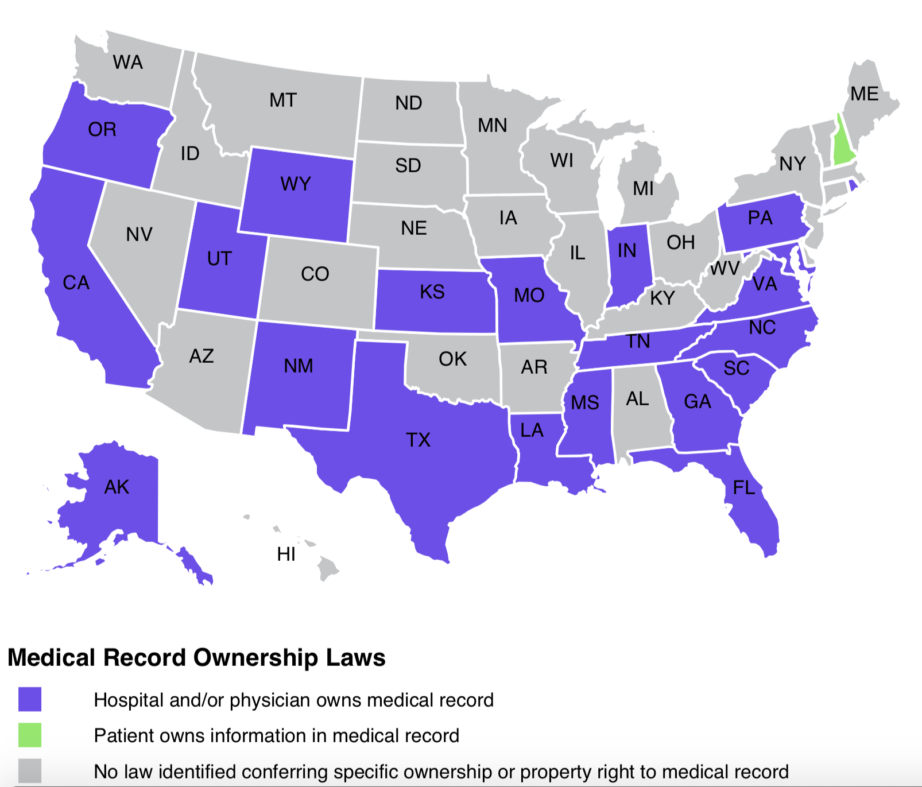
Who Owns Patient Data?
Health care provider who owns the medium in which data is recorded
Patients’ rights: privacy, security, access
http://www.healthinfolaw.org/comparative-analysis/who-owns-medical-records-50-state-comparison
Notes:
There is no federal law that addresses the question of who owns patient data. Some states have laws – e.g. NH states that patients own the information in the record. 20 other states clearly say that the healthcare provider owns the record. And the rest don’t say anything. However, HIPAA does give patients the right to privacy and security of their information and access to it.

Slide 55
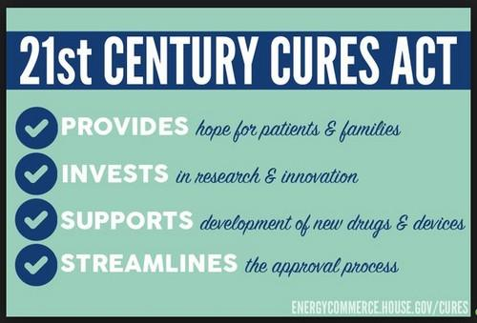
21st Century Cures Act
Electronic patient portals
Test results
Visit notes/after visit summary
+/- Images
Messaging to care team
Billing
Immediate results release
This Photo by Unknown Author is licensed under CC BY-SA-NC
Notes:
Although legally patients are required to be able to access their records, in practice it is sometimes not easy. More recent legislation has underlined this right and also required that healthcare organizations make it as easy as possible for patients to access their information electronically. <talk about 2st CC> We’ll talk more about the implications of the 21st Century Cures Act later in the course.

Slide 56
EAS 5850:
IMAGING INFORMATICS
De-Identification of Medical Data
Dr. Tessa S. Cook

Slide 57
Patient Data: A Reminder
Notes & documents
Vital signs
Test results
Images
Vaccinations
Medications
Administrative
Notes:
Patient data consists of the following (list)
Notes and documents – office visits, inpatient or ED progress notes, procedures
Administrative data belong to both patients as well as the system at large – at the patient level, these include appointment information and insurance and billing data

Slide 58
Who is Exchanging Data?
Researchers
Researchers
Imaging facilities
Registries
Registries
Patients
Vendors
Vendors
Notes:
Sources of data
Imaging facility
Patient (crowdsourcing vs. individual transactions)
Destinations for data
Researcher
Registry (including open-access data based on funding)
Vendor

Slide 59





How is Data Being Transferred?
Cloud
Physical media
Direct upload
Email
Snail mail
Notes:
From a security standpoint, this pretty much runs the gamut from pretty sure (nothing is 100%) to “are you sure that’s a good idea?”

Slide 60
Data Sharing Agreements
IRB: Institutional Review Board Approval
Reviews research protocols for patient safety, data safety, experimental & personnel appropriateness
45 CFR 46 “Protection of Human Subjects” (aka the “Common Rule”)
BAA: Business Associates’ Agreement
Between healthcare organization and vendor partner who requires access to PHI to provide product used for patient care
DUA: Data Use Agreement
Between organizations sharing data for research
Notes:
IRB is based on 45 CFR 46, designed to ensure that research on human subjects, whether prospective or retrospective, interventional or not, only on data or actually on patients, is safe and appropriate and conducted with rigor and appropriate ethics. The members of the IRB are usually physicians and scientists at the same organization.
BAA typically between vendor and hospital/health system/facility that has purchased vendor’s product to use when caring for patients. For example, in radiology, we have a BAA with the vendor that supplies our PACS, because they are able to access PHI when we use their product.
DUAs are specifically for research. They specify what kinds of data will be exchanged, by whom, and when/how the data will be destroyed once the research is concluded.
Unlike the IRB, BAAs and DUAs are legal documents approved and signed by lawyers representing both parties.

Slide 61
Regulating Data Sharing
IRBs, BAAs, DUAs
Broader consent
Notification of waiver of consent for de-identified data?
Dynamic consent by use case?
Exclusivity of agreements?
Geis et al. JACR 2019 16(11): 1516-21
Notes:
Consent for data to be used de-identified for R&D, e.g. at start of treatment
Waiver of consent for de-identified data (currently the norm for many IRBs; should patients still be notified?)

Slide 62

Data Privacy: Considerations
Directly approaching patients for data
Notifying patients about use of their data
Medical + non-medical data – significant risk of privacy breach
This Photo by Unknown Author is licensed under CC BY-SA-NC

Slide 63

You Have Data – Now What?
Is it the right data?
Does it represent what you think it does?
Is it cleaned? organized? normalized? de-identified?
Notes:
De-identification of data is tricky

Slide 64
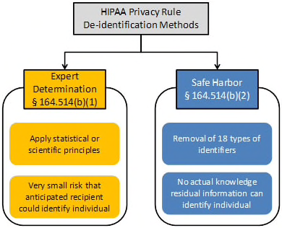
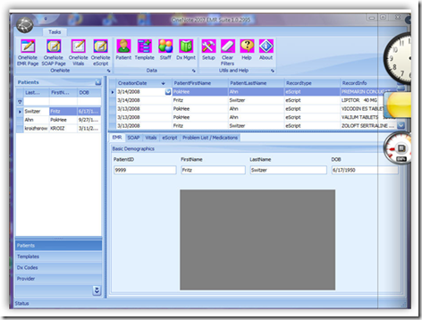
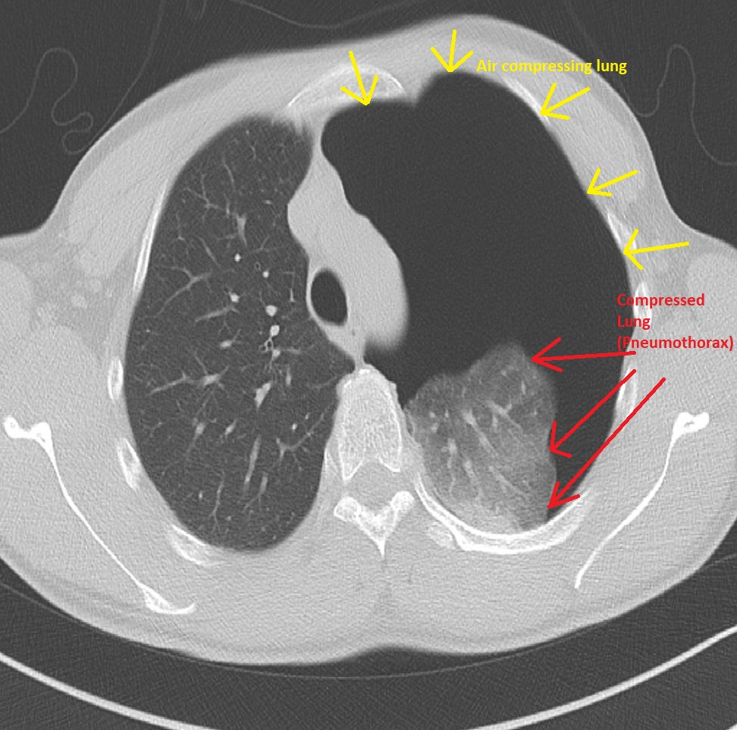

De-Identification of Medical Data
EMR (Notes)
Reports (Text)
Images (DICOM)
https://www.hhs.gov/hipaa/for-professionals/privacy/special-topics/de-identification/index.html#protected
Notes:
HIPAA privacy rule offers two options. We previously talked about the 18 safe harbor identifiers specified by HIPAA. But there are far more well tested DICOM de-id tools out there for images than there are for reports. EMR tools work fairly well and there are a number of them.
But what about data that aren’t expected – patients’ clothing, jewelry, faces? De-id is always more complex than you might think.

Slide 65
HIPAA Safe Harbor Deidentification
18 categories of PHI
Identify & remove PHI
Create anonymized identifiers
Secure mapping table between true and anonymized identifiers
Names | IP addresses | Biometrics
Addresses | Emails | Health plan #s
Dates (except year) | Certificate or license #s | Full face photos
Phone #s | SSNs | Account #s
VIN, SN, license plates | Device IDs, serial #s | Any other unique characteristic or code
Fax #s | MRNs | URLs

Slide 66
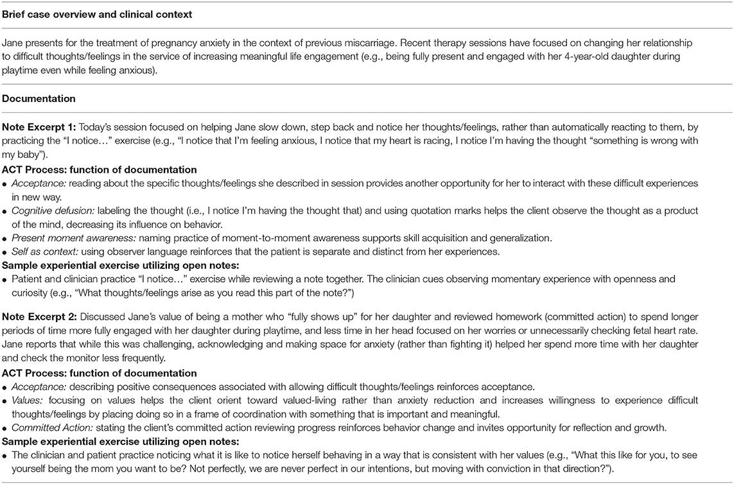
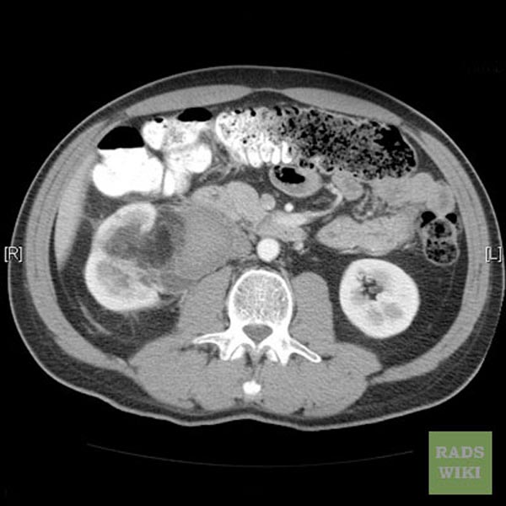
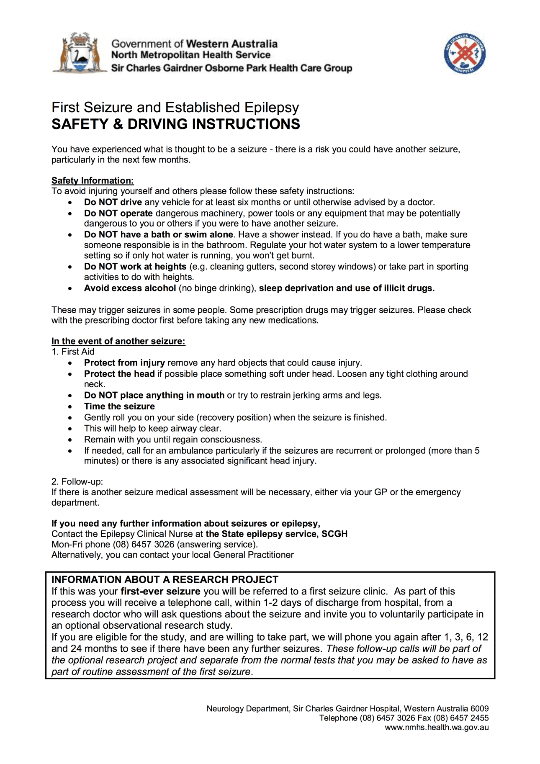
De-Identification of Medical Data
Medical notes
Images (DICOM vs. non-DICOM)
Radiology reports*
Notes:
There are different tools that exist for different types of medical data. Even though medical notes and radiology reports are both text, tools that work well on medical notes do not always work well on radiology reports, and vice versa. This is because PHI occurs at different frequencies in the different types of data. Similarly, there are many tools available for de-identification of DICOM images. They primarily work on the headers of the DICOM images, which is where the PHI are stored. They would not work on images such as photographs of rashes or digital pathology slides, because the image formats are very different. This is why de-identification of medical data becomes so challenging and why sharing of medical data should be done carefully.

Slide 67
EAS 5850:
IMAGING INFORMATICS
Patient and Data Safety
Dr. Tessa S. Cook

Slide 68

Data Commoditization
Freely available data benefits patients and the greater good
”Good” data cannot be generated for free
This Photo by Unknown Author is licensed under CC BY-SA-NC
Notes:
Industries—including healthcare—realized early on that the secret to good AI was good training data. But healthcare data is not easy to get. This created an unexpected economy because in order to develop good products, companies had to acquire good data. This created a new commodity in the form of good data with which to train healthcare AI. But what does good mean?
Good = Robust, Annotated, Curated
But good data cannot be generated for free (labeling and curating are “expensive”),. So the field is now focused on creative and automated ways to label data.

Slide 69

Managing (Large) Datasets
Prioritize data protection
Monitor & limit access
Schedule & monitor updates
Periodically QC data
Sharing – to whom and for what purpose?
Notes:
Not just lip service to get IRB approval

Slide 70
Patients’ Data (Safety) Concerns
How much data is being used?
Who can access it?
How well is it anonymized or de-identified?
Can it be used to harm me?
Can it be altered?
Is it financially benefitting others?
Will changes in privacy policy affect my care?
J. L. Jaremko et al. / Canadian Association of Radiologists Journal 70 (2019) 107e118
Notes:
The comments in this paper from the Canadian Association of Radiologists journal aligns with comments and feedback from patient advocates within the American College of Radiology. <go through each item>

Slide 71

Societal Data Safety Concerns
Selection bias due to mandatory consent
Risk of data breach
Risk of commoditization of personal data
J. L. Jaremko et al. / Canadian Association of Radiologists Journal 70 (2019) 107e118
This Photo by Unknown Author is licensed under CC BY-SA-NC

Slide 72
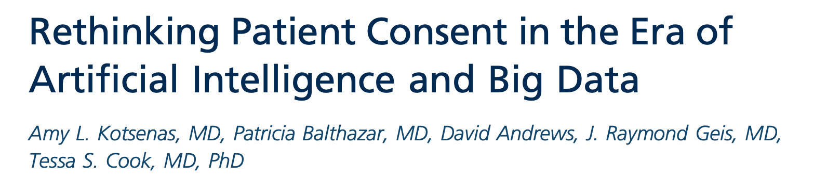
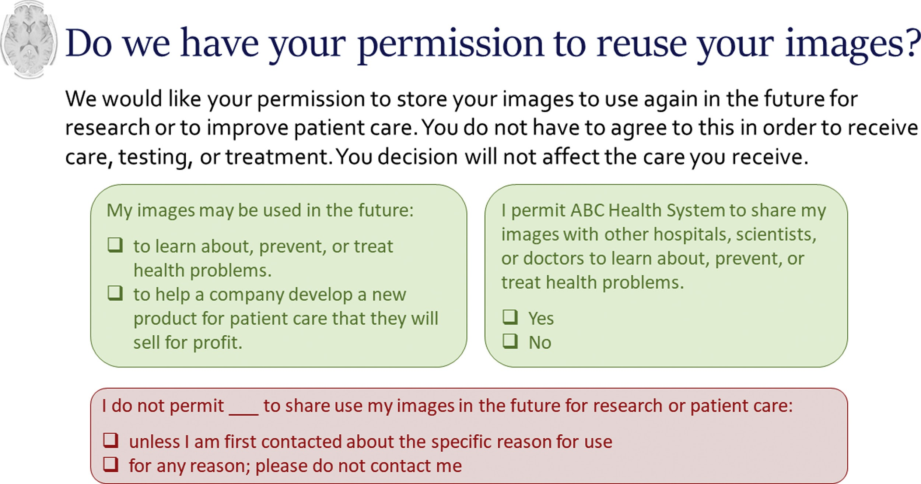
Reinventing Patient Consent
https://www.jacr.org/article/S1546-1440(20)30965-0/fulltext
Notes:
Most healthcare facilities require that patients sign a generic consent for treatment . At academic medical centers such as Penn, the consent broadly covers use of patients’ data for clinical care, research, and teaching. It does not specify whether or not data might be used for commercial purposes. In a provocative issue of the Journal of the American College of Radiology a few years ago, some colleagues and I proposed a more specific consent process that might better empower patients to have a say in how their data is used. Admittedly this is only a prototype but it gives patients the opportunity to specify how and when their data could be used. Even when patients generically consent for reuse of their data, we should be responsible in how—and how much—data we use for research, development, and innovation.

